Slide 1
ASP.NET MVC
Lesson 3 Reading Data

Slide 2
Reading Data
Reading data using the DBContext class
Lambda syntax
ViewData ⬄ View Model
@model IEnumerable<MvcMovie.Models.Movie>
@model MvcMovie.Models.Movie
DataAnnotations

Slide 3
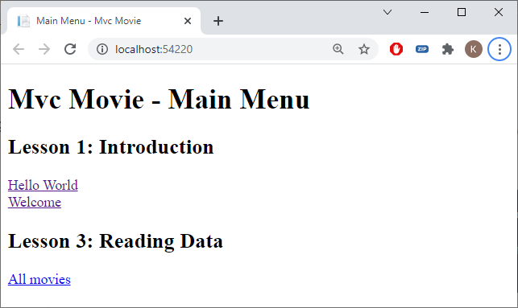
Mvc Movie - Home/Index.cshtml
<h2>Lesson 3: Reading Data</h2>
<a asp-controller="Movies" asp-action="List">All movies</a>

Slide 4
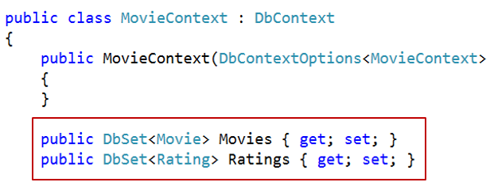
MoviesController.cs
Controllers
Add New Item | MVC Controller - Empty
MoviesController.cs
using Microsoft.AspNetCore.Mvc;
using MvcMovie.Data;
namespace MvcMovie.Controllers
{
public class MoviesController : Controller
{
private readonly MovieContext _context;
public MoviesController(MovieContext context)
{
_context = context;
}
public IActionResult List()
{
return View();
}
}
}

Slide 5
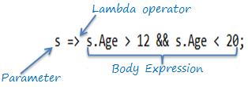
Lambda Expressions
Lambda expression to specify how to read data from Movies DBSet in the DBContext
But also: search in lists, sort collections, …
Input_parameter => expression or statement block
=> reads as goes to

Slide 6
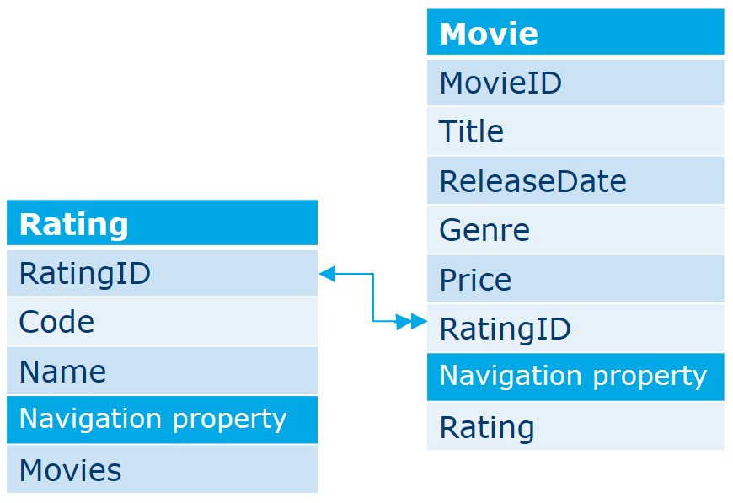
Some examples
var movies =
_context.Movies
.Where(m => m.Genre == "Western" && m.Price < 10)
.OrderBy(m => m.Title);
var movie =
_context.Movies
.Include(m => m.Rating)
.SingleOrDefault(m => m.MovieID == 1);
var movies =
_context.Movies
.Include(m => m.Rating)
.Where(m => m.MovieID == 1); // can you see the difference with the previous statement?
var movie =
_context.Movies
.Include(m => m.Rating)
.Where(m => m.MovieID == 1).Single();
var firsttitle =
_context.Movies
.Where(m => m.MovieID == 1)
.Select(m => m.Title).Single();

Slide 7
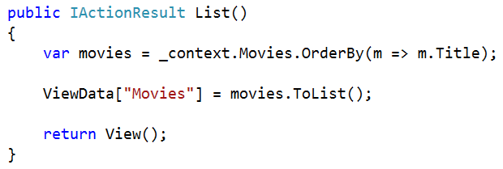
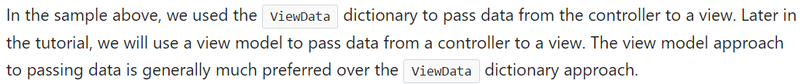
Read all movies (ViewData ⬄ View Model)
using System.Linq;
public IActionResult List()
{
var movies = _context.Movies.OrderBy(m => m.Title);
return View(movies.ToList());
}

Slide 8
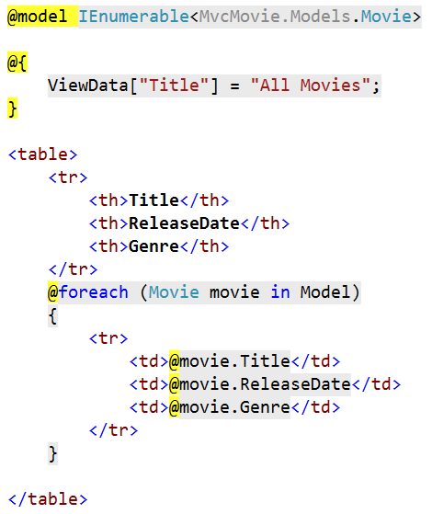
Show All movies (resources oR Code-site)
Views | Add New Folder | Movies
Movies | Add New Item | List.cshtml

Slide 9
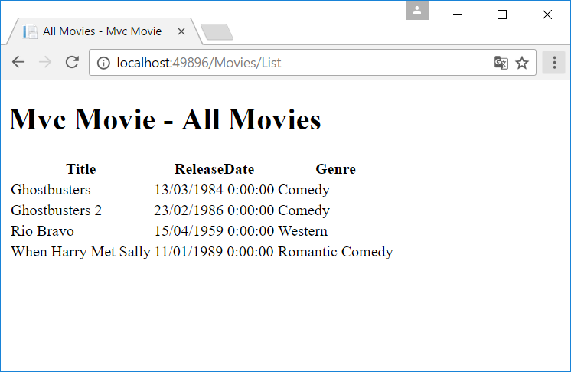
All Movies

Slide 10
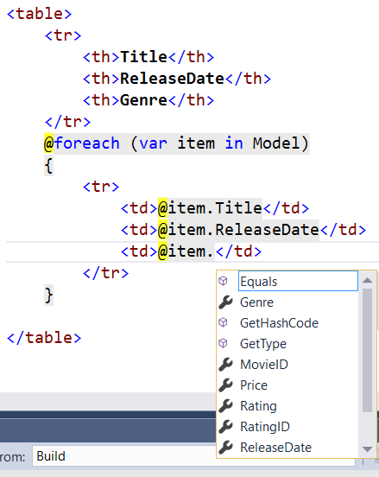
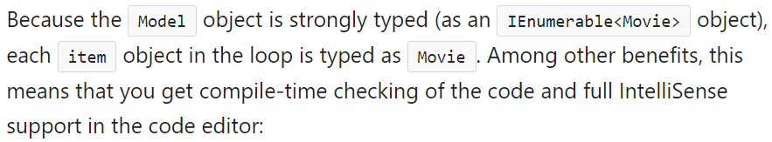
Var keyword

Slide 11
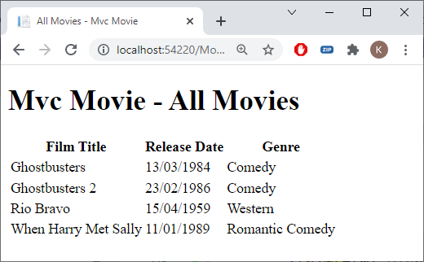
Html Helpers (DisplayFor & DisplayNameFor)

Slide 12
Date FOrmat
Can be done in View but must be repeated in each view
Better with DataAnnotation and html helper
[DataType(DataType.Date)]
[DisplayFormat(ApplyFormatInEditMode = true,
DataFormatString = "{0:dd/MM/yyyy}")]
public DateTime ReleaseDate { get; set; }

Slide 13
Date FOrmat

Slide 14
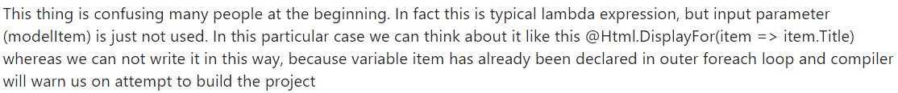
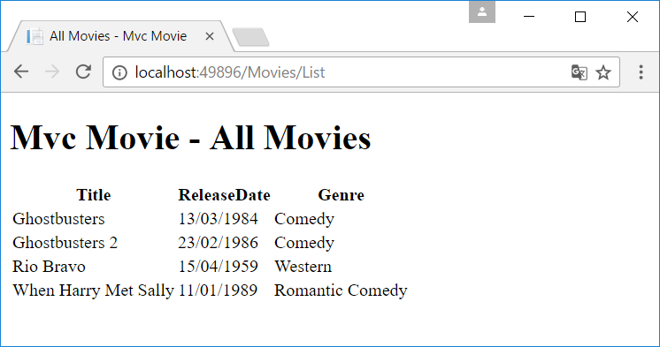
With html helper
@foreach (var item in Model)
{
<tr>
<td>@(Html.DisplayFor(modelItem => item.Title))</td>
<td>@(Html.DisplayFor(modelItem => item.ReleaseDate))</td>
<td>@(Html.DisplayFor(modelItem => item.Genre))</td>
</tr>
}

Slide 15
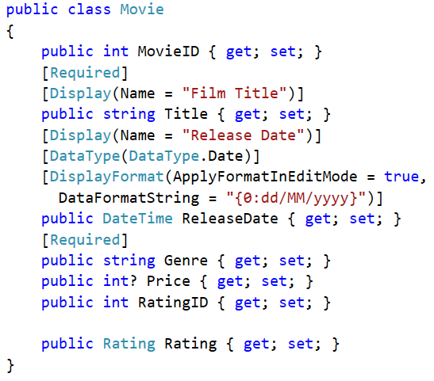
Movie.cs

Slide 16
Use a Html Helper to display the heading
...
<table>
<tr>
<th>@(Html.DisplayNameFor(model => model.Title))</th>
<th>@(Html.DisplayNameFor(model => model.ReleaseDate))</th>
<th>@(Html.DisplayNameFor(model => model.Genre))</th>
</tr>
@foreach (var item in Model)
{
<tr>
<td>@(Html.DisplayFor(modelItem => item.Title))</td>
<td>@(Html.DisplayFor(modelItem => item.ReleaseDate))</td>
<td>@(Html.DisplayFor(modelItem => item.Genre))</td>
</tr>
}
</table>

Slide 17
Movie.cs

Slide 18
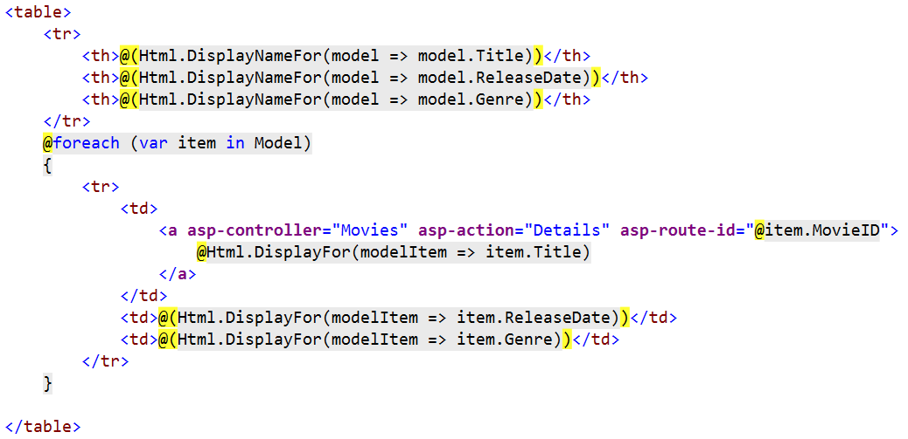
Tag helper

Slide 19
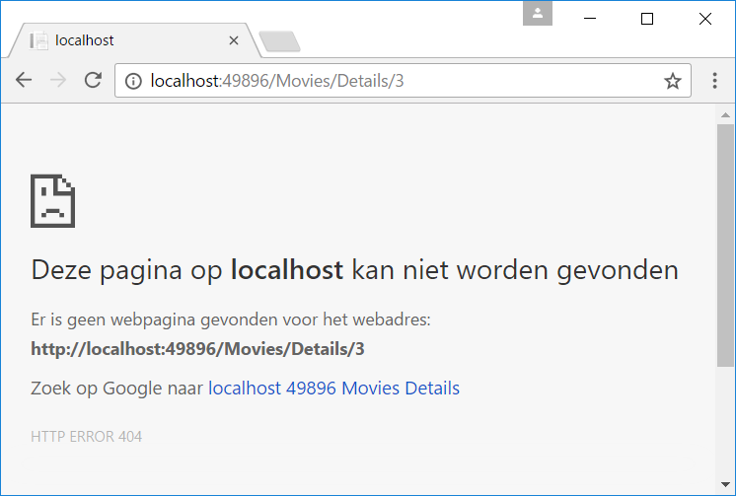
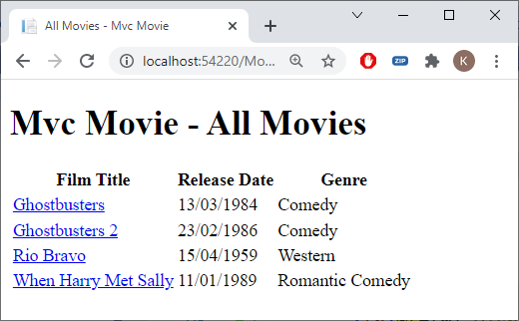
Tag Helper

Slide 20
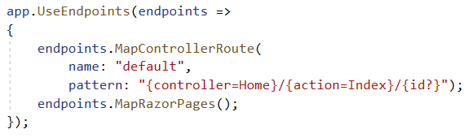
Details
using Microsoft.EntityFrameworkCore;
public IActionResult Details(int id)
{
var movie = _context.Movies
.Include(m => m.Rating)
.SingleOrDefault(m => m.MovieID == id);
return View(movie);
}

Slide 21
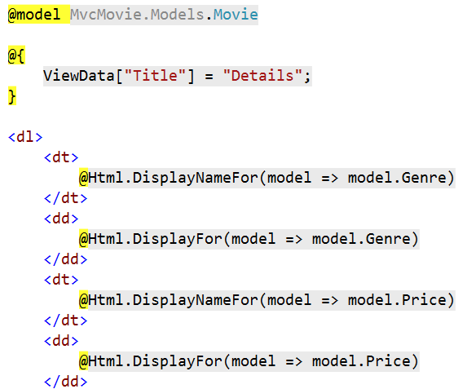
Movies/Details.cshtml (resources or code-site)
Movies | Add New Item | Details.cshtml

Slide 22
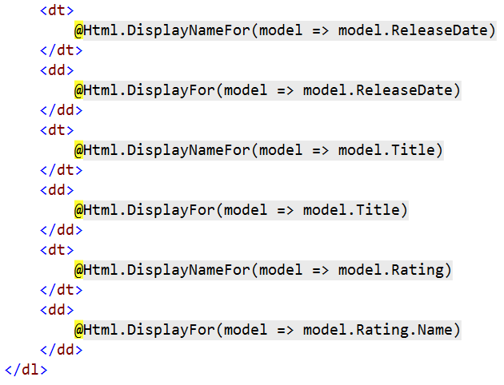
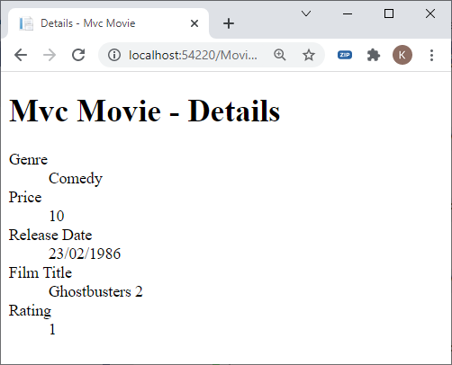
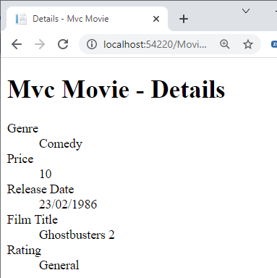
Movies/Details.cshtml

Slide 23
Exercise
MotoGP Part 3

